Slide 1
Image Based Price Estimation Model
CSE 498: Deep Learning
Sponsor: Dr. Parv Venkitasubramaniam
Yan Huang, Vyshnavi Kondapalli, Xiang Gao, Lauri Soome

Slide 2




Yan H.
Meet the Team
Vyshnavi K.
Xiang G.
Lauri S.
M.S Data Science
yah423@lehigh.edu
M.S Data Science
vyk223@lehigh.edu
M.S Data Science
xig423@lehigh.edu
M.S Data Science
las623@lehigh.edu

Slide 3
Musical Instruments & Pre-Owned Marketplace
Motivation
About 50% of all students drop out of music lessons and activities by the time they turn 17 years old.
The pricing of musical instruments is complex, posing challenges for beginners to navigate.
A potential market between individuals discontinuing musical pursuits and those newly interested in engaging musical activities.

Slide 4
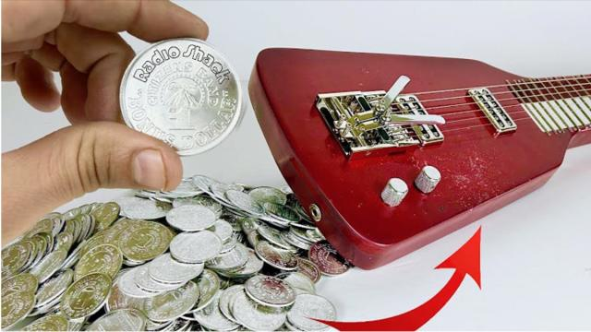
How to assist both beginners and sellers in determining a fair price for used musical instruments?
Question

Slide 5
Project Profile
Goal: Determine the value of used acoustic guitars.
Methodology: Develop deep learning models to estimate prices using images of used guitars.
Dataset: Compile guitar images and relevant details (condition, brand, price) scraped from Guitar Center's website.
Result: Create a Web Application capable of predicting a price range upon uploading a guitar image.

Slide 6
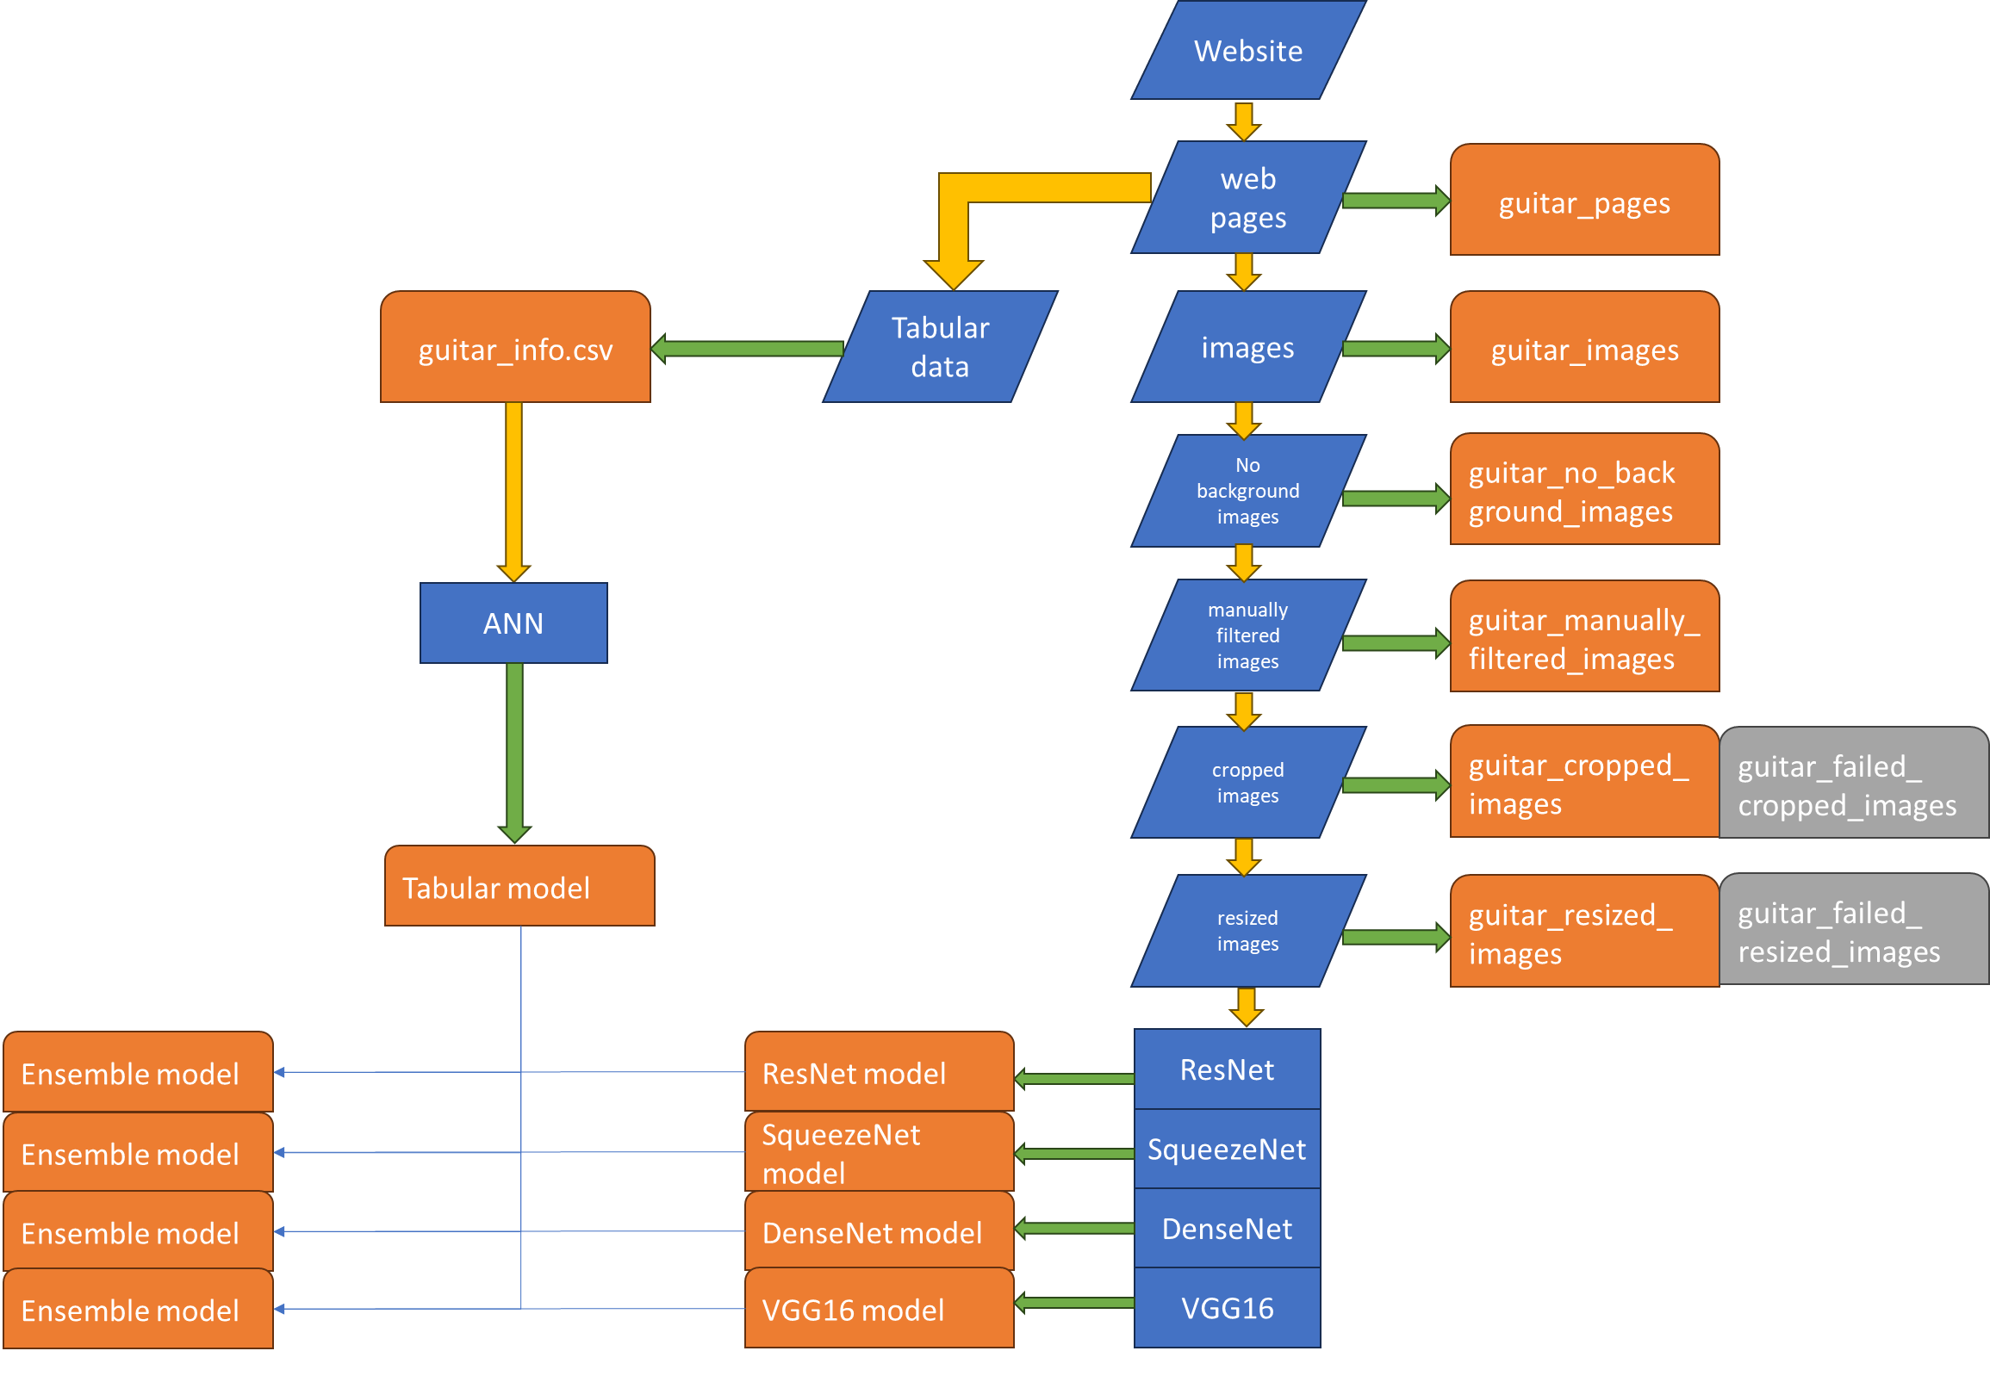
Project WorkFlow
data
Algorithm/
Model
Directory/file

Slide 7
Algorithm & Model
Price Binning: Segmentation of prices into 8 distinct price ranges.
Tabular Model: Four-Layer Fully Connected Network with Dropout.
Image Model: ResNet, SqueezeNet, DenseNet, and VGG16.
Ensemble Model: Integration of tabular and image models, adding two fully connected layers for classification tasks.

Slide 8
Architecture
Tabular Data Model
ResNet Model
SqueezeNet Model
DenseNet Model
VGG16 Model

Slide 9
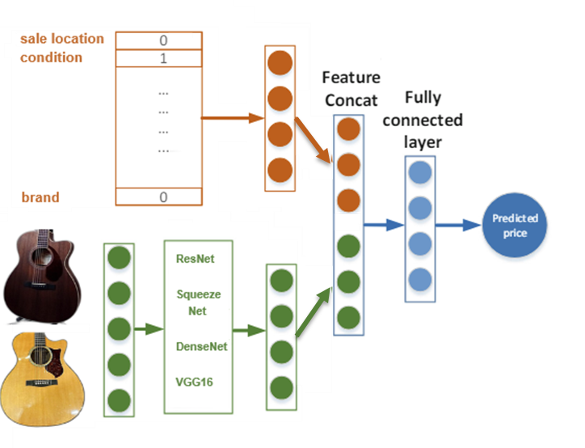
Architecture
Ensemble Model

Slide 10
Results
Achieved a model accuracy of 44%, with no performance gains from using an ensemble approach.

Slide 11

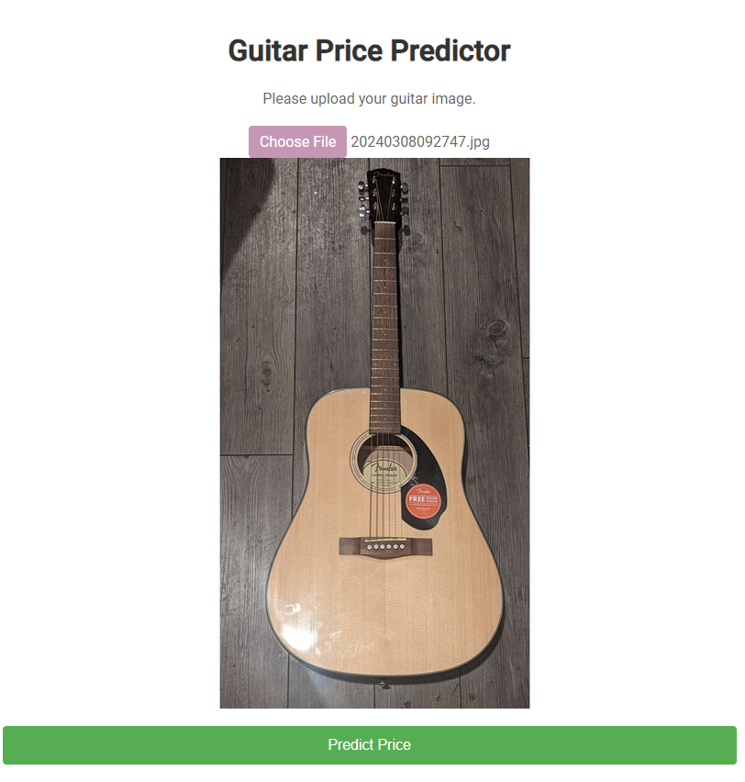
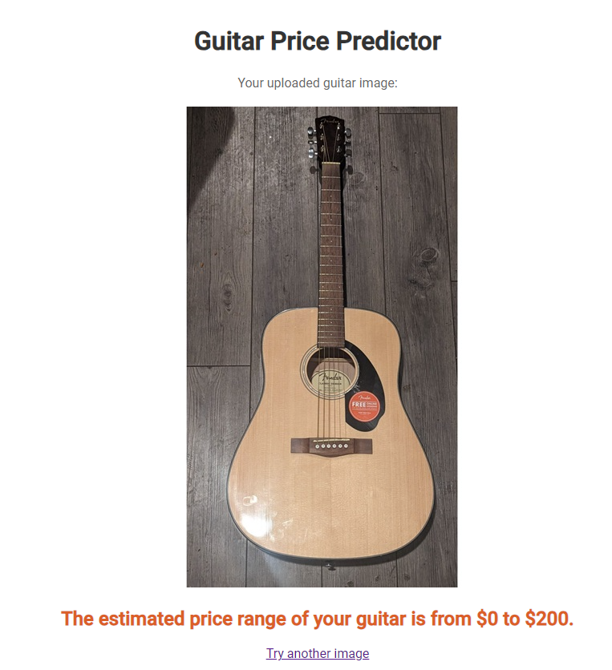
Web Application

Slide 12
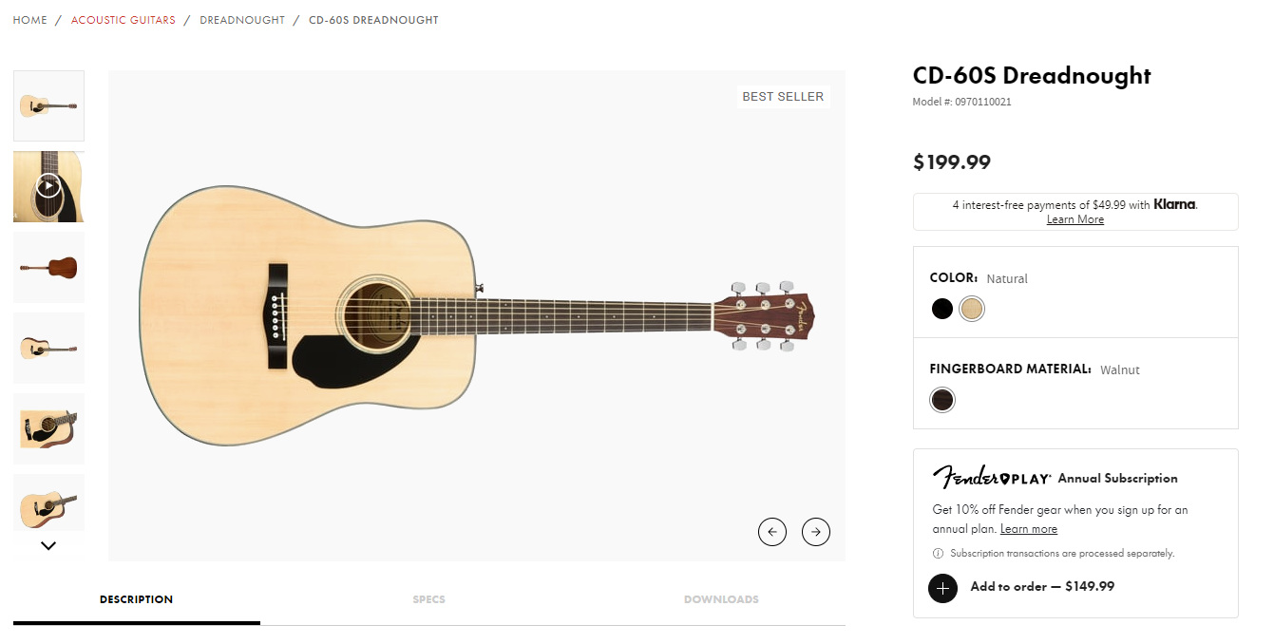
Web Application

Slide 13
Challenge & Opportunity
1. Model Scope Definition
Collaborated with a musical instructor to identify important guitar part for price prediction.
2. Isolate Essential Component
Developed a heuristic algorithm to exclusively crop the top soundboard of guitar images.
3. Image Noise Management
Applied data augmentation with torchvision.transforms to correct for variations in images (perspective, light intensity, and angle).
4. Low Prediction Accuracy
Expand the dataset with diverse data types, including audio.

Slide 14
Thank You

